Slide 1

MesoNet: Facial Video Counterfeit Detection Network Analysis
Team:
Ravi Sankar Gogineni – R11788968

Slide 2
CONTENTS:
Abstract
Introduction
Deepfake and Face2Face
Proposed Method
Meso-4 and Mesoinception-4
Experiment
Results
Conclusion
References

Slide 3
ABSTRACT:
This project presents a method to automatically and efficiently detect face tampering in videos, and particularly focuses on two recent techniques used to generate hyper realistic forged videos: Deepfake and Face2Face.
Traditional image forensics techniques are usually not well suited to videos due to the compression that strongly degrades the data given.
This project follows a deep learning approach and presents two networks, both with a low number of layers to focus on the mesoscopic properties of images.
We evaluated those fast networks on both an existing dataset and a dataset we have constituted from online videos. The tests demonstrate a very successful detection rate for Deepfake and Face2Face.

Slide 4
INTRODUCTION:
Over the last decades, the popularization of smartphones and the growth of social networks have made digital images and videos very common digital objects.
This tremendous use of digital images has been followed by a rise of techniques to alter image contents, using editing software like Photoshop for instance.
Today, the danger of fake news is widely acknowledged and, in a context, where more than 100 million hours of video content are watched daily on social networks, the spread of falsified video raises more and more concerns.
Most methods used with images can not be directly extended to videos, which is mainly due to the strong degradation of the frames after video compression. Current video forensic studies mainly focus on the video re-encoding and video recapture; however, video edition is still challenging to detect.
Deep learning methods has been successfully employed for digital image forensics.
Deep learning can also be used to falsify videos. Recently, a powerful tool called Deepfake has been designed for face capture and reenactment. This methods, initially devoted to the creation of adult content, has not been presented in any academic publication. Deepfake follows Face2Face, a non deep learning method introduced that target's similar goal, using more conventional real-time computer vision techniques.

Slide 5
Progress
Phase 1:- Gathering the requirements and scrutinizing few related papers
Phase 2 :- Downloading the datasets and testing with different number of layers and to generate hyper realistic forged Deepfake and Face2face videos/images.
Phase 3:- Evaluate the results on the tested dataset and verify the detection rate on both Deepfake and Face2Face

Slide 6
Deepfake:
Deepfake is a technique which aims to replace the face of a targeted person by the face of someone else in a video.
The core idea lies in the parallel training of two autoencoders
An auto-encoder designates the chaining of an encoder network and a decoder network. The purpose of the encoder is to perform a dimension reduction by encoding the data from the input layer into a reduced number of variables. The goal of the decoder is then to use those variables to output an approximation of the original input.
In the case of the Deepfake technique, the original auto-encoder is fed with images of resolution 64 × 64 × 3 = 12, 288 variables, encodes those images on 1024 variables and then generates images with the same size as the input.

Slide 7
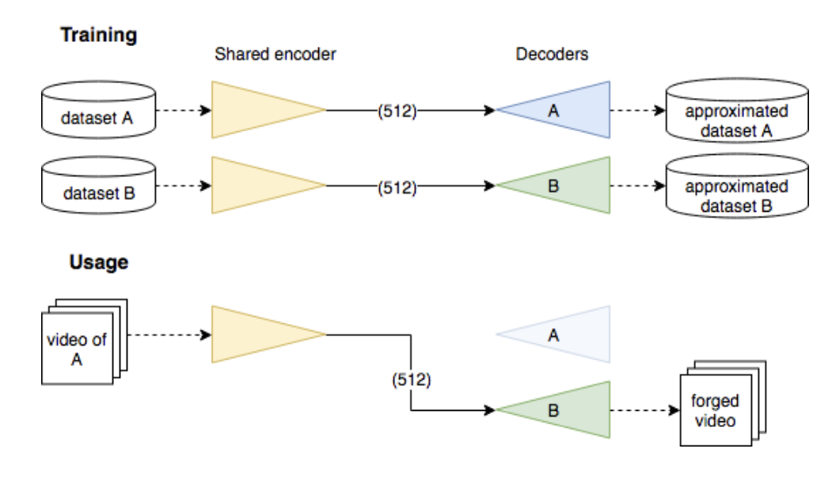
The process to generate Deepfake images is to gather aligned faces of two different people A and B, then to train an auto-encoder E_{A} to reconstruct the faces of A from the dataset of facial images of A, and an auto-encoder E_{B} to reconstruct the faces of B from the dataset of facial images of B.
The trick consists in sharing the weights of the encoding part of the two auto-encoders E_{A} and E_{B}, but keeping their respective decoder separated.
Once the optimization is done, any image containing a face of A can be encoded through this shared encoder but decoded with decoder of E_{B}.

Slide 8
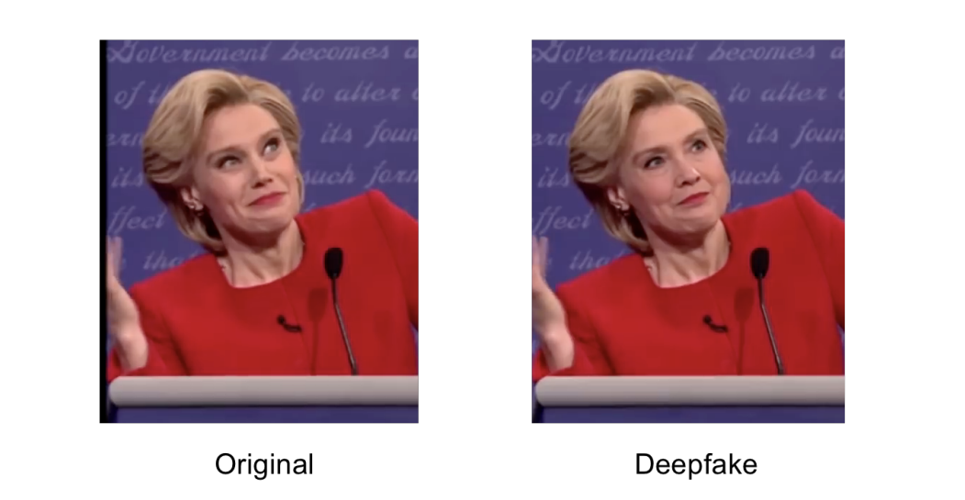
Basically, the extraction of faces and their reintegration can fail, especially in the case of face occlusions: some frames can end up with no facial reenactment or with a large blurred area or a doubled facial contour
However, those technical errors can easily be avoided with more advanced networks. More deeply, and this is true for other applications, autoencoders tend to poorly reconstruct fine details because of the compression of the input data on a limited encoding space, the result thus often appears a bit blurry.

Slide 9
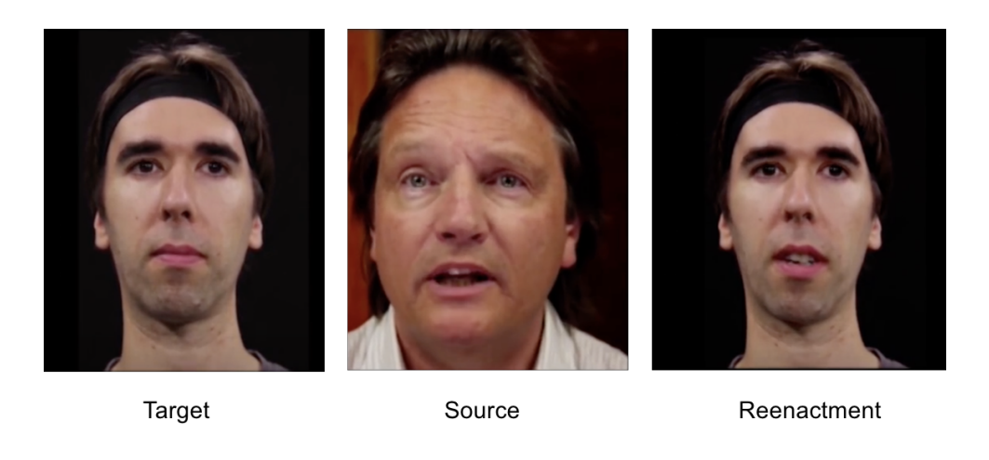
Face2Face:
Reenactment methods, are designed to transfer image facial expression from a source to a target person.
It performs a photorealistic and marker less facial reenactment in real-time from a simple RGB-camera. The program first requires few minutes of prerecorded videos of the target person for a training sequence to reconstruct its facial model.
At runtime, the program tracks both the expressions of the source and target actor's video. The final image synthesis is rendered by overlaying the target face with a morphed facial blend shape to fit the source facial expression.

Slide 10
PROPOSED METHOD:
The methodology is the several effective approaches to deal with either Deepfake or Face2Face.
Proposed method is to detect forged videos of faces by placing our method at a mesoscopic(on a scale between microscopic and macroscopic) level of analysis. Indeed, microscopic analyses based on image noise cannot be applied in a compressed video context where the image noise is strongly degraded.
Similarly, at a higher semantic level, human eye struggles to distinguish forged images, especially when the image depicts a human face. That is why we propose to adopt an intermediate approach using a deep neural network with a small number of layers.

Slide 11
Meso-4:
This network begins with a sequence of four layers of successive convolutions and pooling and is followed by a dense network with one hidden layer.
To improve generalization, the convolutional layers use ReLU activation functions that introduce non-linearities and Batch Normalization to regularize their output and prevent the vanishing gradient effect, and the fully-connected layers use Dropout to regularize and improve their robustness.

Slide 12
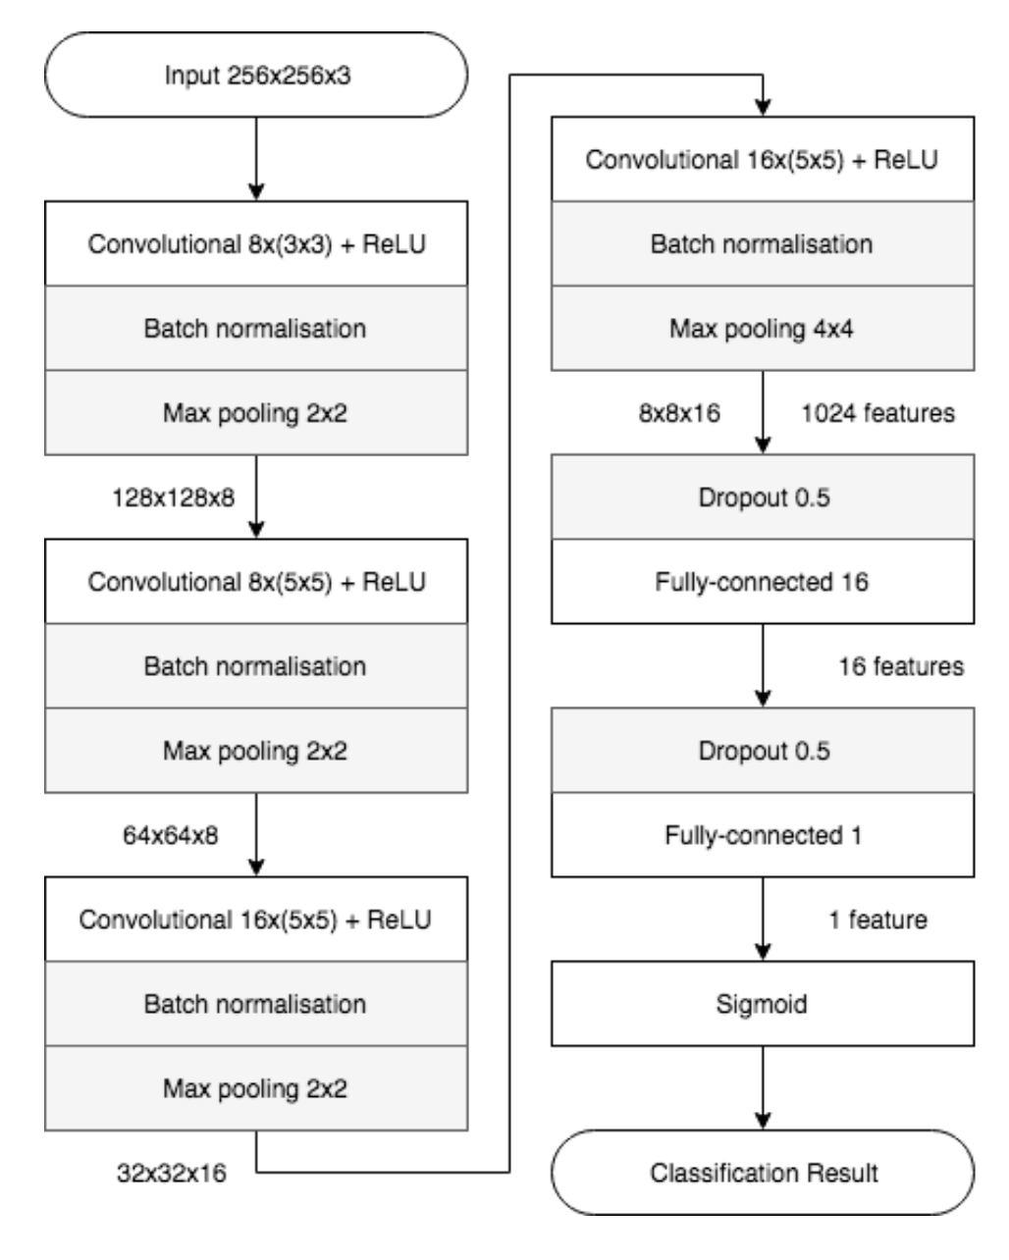
The network architecture of Meso-4. Layers and parameters are displayed in the boxes, output sizes next to the arrows.

Slide 13
MesoInspection:
It is basically an alternative structure formed by replacing the first two convolution layers of Meso-4 by a variant of the inception module
The idea of the module is to stack the output of several convolutional layers with different kernel shapes and thus increase the function space in which the model is optimized.
Instead of the 5 × 5 convolutions of the original module, we propose to use 3 × 3 dilated convolutions in order to avoid high semantic.
This idea of using dilated convolutions with the inception module can be found as a means to deal with multi-scale information, a 1×1 convolutions before dilated convolutions for dimension reduction and an extra 1×1 convolution in parallel that acts as skip-connection between successive modules.

Slide 14
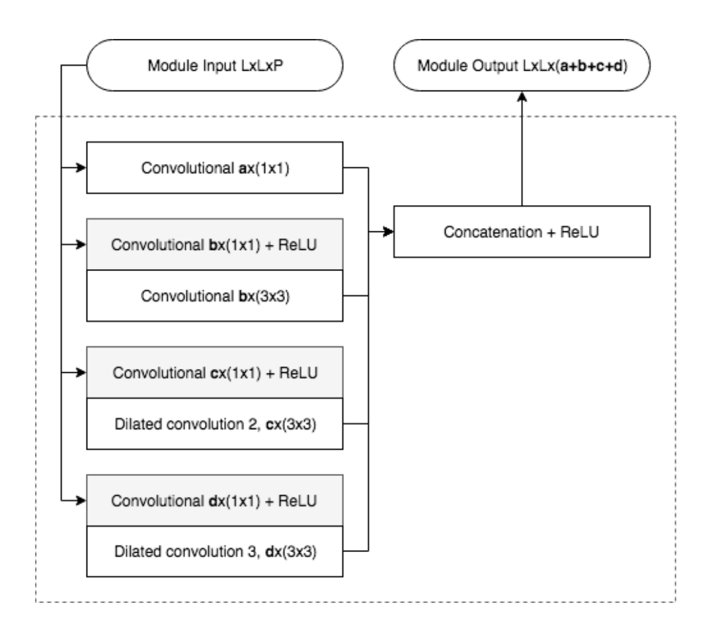
Architecture of the inception modules used in MesoInception-4. The module is parameterized using a, b, c, d ∈ N. The dilated convolutions are computed without stride.

Slide 15
EXPERIMENTS
we expose the results of the implementation of the two proposed architectures to detect the studied digital forgeries. In order to extend our work to the real case of online videos, we also discuss the robustness of our method to video compression.
The following slides will give a brief idea about the datasets we considered for the experimentation.

Slide 16
DATASETS
DEEPFAKE DATASET:
Training auto-encoders for the forgery task requires several days of training with conventional processors to achieve realistic results and can only be done for two specific faces at a time. To have a sufficient variety of faces, we have rather chosen to download the profusion of videos available to the general public on the internet.
Thus, 400 of forged videos have been collected from different platforms. Their duration ranges from approximately 7-10 seconds and have a minimum resolution of 1920*1080 pixels.

Slide 17
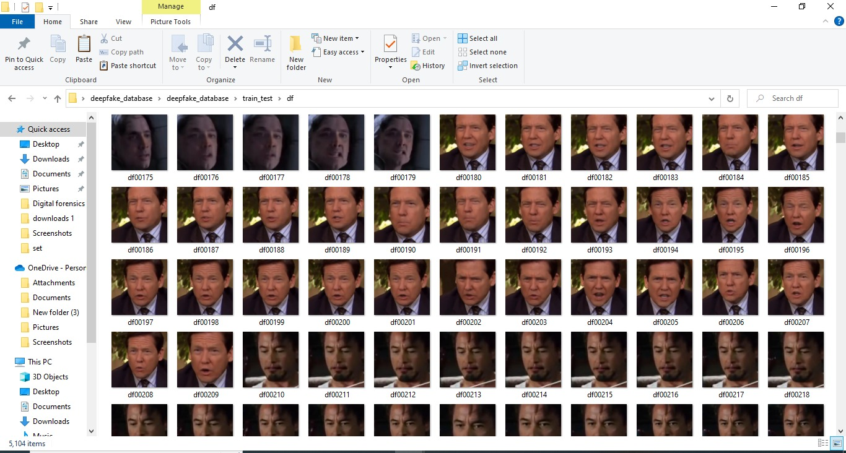

Slide 18
DATASETS
FACE2FACE:
Additionally, to the Deepfake dataset, we have examined whether the proposed architecture could be used to detect other face forgeries.
The Face Forensics dataset contains over a thousand forged videos and their original using the Face2Face approach. This dataset is already split into a training, validation and testing set.

Slide 19
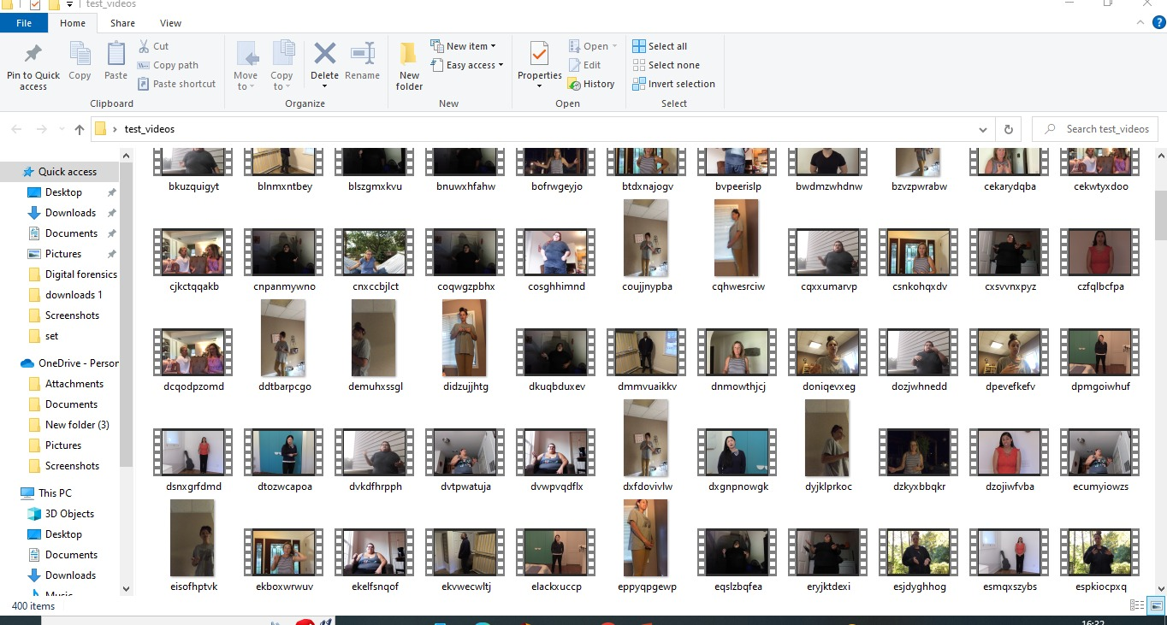

Slide 20

RESULTS:
Predicted : [[0.04141179]]
Real class : [0.]
with meso_f2f classifier:
Predicted : [[0.8810234]]
Real class : [1.]
Dealing with video aassnaulhq.mp4
Face extraction warning : 0 - no face
Face extraction warning : 10 - no face
Face extraction warning : 20 - no face
Face extraction warning : 30 - no face
Face extraction warning : 40 - no face
Face extraction warning : 50 - no face
Face extraction warning : 60 - no face
Face extraction warning : 70 - found face in full frame [(80, 469, 155, 395)]
Face extraction warning : 80 - found face in full frame [(174, 931, 308, 797)]
Face extraction report of not_found : 9
Face extraction report of no_face : 7
Predicting aassnaulhq.mp4
2022-12-04 20:26:40.263287: W

Slide 21
tensorflow/core/framework/cpu_allocator_impl.cc:80] Allocation of 18087936 exceeds 10% of free system memory.
2022-12-04 20:26:40.280015: W tensorflow/core/framework/cpu_allocator_impl.cc:80] Allocation of 48234496 exceeds 10% of free system memory.
2022-12-04 20:26:40.397870: W tensorflow/core/framework/cpu_allocator_impl.cc:80] Allocation of 48234496 exceeds 10% of free system memory.
2022-12-04 20:26:40.447838: W tensorflow/core/framework/cpu_allocator_impl.cc:80] Allocation of 12058624 exceeds 10% of free system memory.
2022-12-04 20:26:40.483133: W tensorflow/core/framework/cpu_allocator_impl.cc:80] Allocation of 12058624 exceeds 10% of free system memory.
Dealing with video aayfryxljh.mp4
Face extraction warning : 0 - found face in full frame [(422, 1085, 615, 892)]
Face extraction report of not_found : 1
Face extraction report of no_face : 0
Predicting aayfryxljh.mp4
Dealing with video acazlolrpz.mp4
Face extraction warning : 0 - found face in full frame [(423, 1474, 584, 1314)]
Face extraction report of not_found : 1
Face extraction report of no_face : 0
Predicting acazlolrpz.mp4
Dealing with video adohdulfwb.mp4

Slide 22
Face extraction warning : 0 - found face in full frame [(148, 969, 379, 738)]
Face extraction report of not_found : 1
Face extraction report of no_face : 0
Predicting adohdulfwb.mp4
Dealing with video ahjnxtiamx.mp4
Face extraction warning : 0 - found face in full frame [(337, 892, 529, 700)]
Face extraction report of not_found : 1
Face extraction report of no_face : 0
Predicting ahjnxtiamx.mp4
Dealing with video ajiyrjfyzp.mp4
Face extraction warning : 0 - found face in full frame [(423, 1403, 584, 1243)]
Face extraction warning : 99 - found face in full frame [(405, 1385, 566, 1225)]
Face extraction report of not_found : 2
Face extraction report of no_face : 0
Predicting ajiyrjfyzp.mp4
Dealing with video aktnlyqpah.mp4
Face extraction warning : 0 - found face in full frame [(328, 917, 559, 686)]
Face extraction report of not_found : 1
Face extraction report of no_face : 0
Predicting aktnlyqpah.mp4
Dealing with video alrtntfxtd.mp4

Slide 23
Face extraction warning : 0 - no face
Face extraction warning : 11 - no face
Face extraction warning : 22 - no face
Face extraction warning : 33 - no face
Face extraction warning : 44 - no face
Face extraction warning : 55 - no face
Face extraction warning : 66 - no face
Face extraction warning : 77 - found face in full frame [(146, 511, 221, 436)]
Face extraction warning : 88 - found face in full frame [(293, 1005, 427, 872)]
`aayfryxljh` video class prediction : 0.9642857142857143
`acazlolrpz` video class prediction : 1.0
`adohdulfwb` video class prediction : 1.0
`ahjnxtiamx` video class prediction : 1.0
`ajiyrjfyzp` video class prediction : 0.9642857142857143
`aktnlyqpah` video class prediction : 1.0
`alrtntfxtd` video class prediction : 0.8571428571428571
`aomqqjipcp` video class prediction : 0.9666666666666667
PS C:\Users\MEGHANA\Downloads\MesoNet>

Slide 24
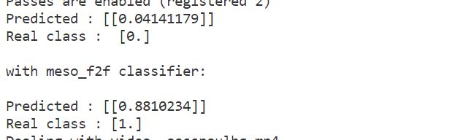
IMAGE RESULTS

Slide 25
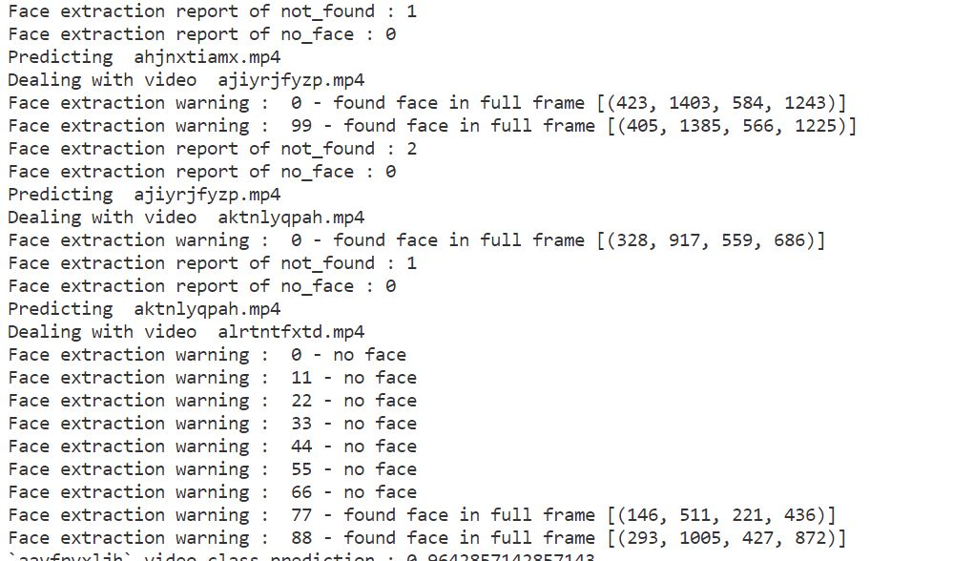
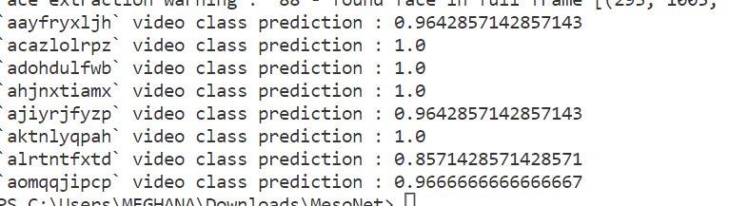
VIDEO RESULTS

Slide 26
CONCLUSION
These days, the dangers of face tampering in video are widely recognized. We provide two possible network architectures to detect such forgeries efficiently and with a low computational cost.
In addition, we give access to a dataset devoted to the Deepfake approach. Our experiments show that our method has shown best results by using Face2Face videos under real conditions of diffusion on the internet.
One fundamental aspect of deep learning is to be able to generate a solution to a given problem without the need of a prior theoretical study.
However, it is vital to be able to understand the origin of this solution in order to evaluate its qualities and limitations.
We understood that the eyes and mouth play an important role in the detection of faces forged with Deepfake. We believe that more tools will emerge in the future toward an even better understanding of deep networks to create more effective and efficient ones.

Slide 27
REFERENCES
B. Balas and C. Tonsager. Face animacy is not all in the eyes: Evidence from contrast chimeras. Perception, 43(5):355– 367, 2014. 3
B. Bayar and M. C. Stamm. A deep learning approach to universal image manipulation detection using a new convolutional layer. In Proceedings of the 4th ACM Workshop on Information Hiding and Multimedia Security, pages 5–10. ACM, 2016.
F. Chollet. Xception: Deep learning with depthwise separable convolutions. arXiv preprint, pages 1610–02357, 2017.
D. Erhan, Y. Bengio, A. Courville, and P. Vincent. Visualizing higher-layer features of a deep network. University of Montreal, 1341(3):1, 2009.
S. Ioffe and C. Szegedy. Batch normalization: Accelerating deep network training by reducing internal covariate shift. arXiv preprint arXiv:1502.03167, 2015.
N. Srivastava, G. Hinton, A. Krizhevsky, I. Sutskever, and R. Salakhutdinov. Dropout: A simple way to prevent neural networks from overfitting. The Journal of Machine Learning Research, 15(1):1929–1958, 2014
P. Viola and M. Jones. Rapid object detection using a boosted cascade of simple features. In Computer Vision and Pattern Recognition, 2001. CVPR 2001. Proceedings of the 2001 IEEE Computer Society Conference on, volume 1, pages I–I. IEEE, 2001.
J.-W. Lee, M.-J. Lee, T.-W. Oh, S.-J. Ryu, and H.-K. Lee. Screenshot identification using combing artifact from interlaced video. In Proceedings of the 12th ACM workshop on Multimedia and security, pages 49–54. ACM, 2010.
J. Thies, M. Zollhofer, M. Stamminger, C. Theobalt, and M. Nießner. Face2face: Real-time face capture and reenactment of rgb videos. In Proceedings of the IEEE Conference on Computer Vision and Pattern Recognition, pages 2387– 2395, 2016.

Slide 28
THANK YOU

